Slide 1


Gone Phishing: The Real Cost of Default Credentials at Sea
beersc@colostate.edu

Slide 2
Agenda
Research Objectives
Background
Methodology
Key Findings
Demonstrations
Recommendations & Future Work

Slide 3
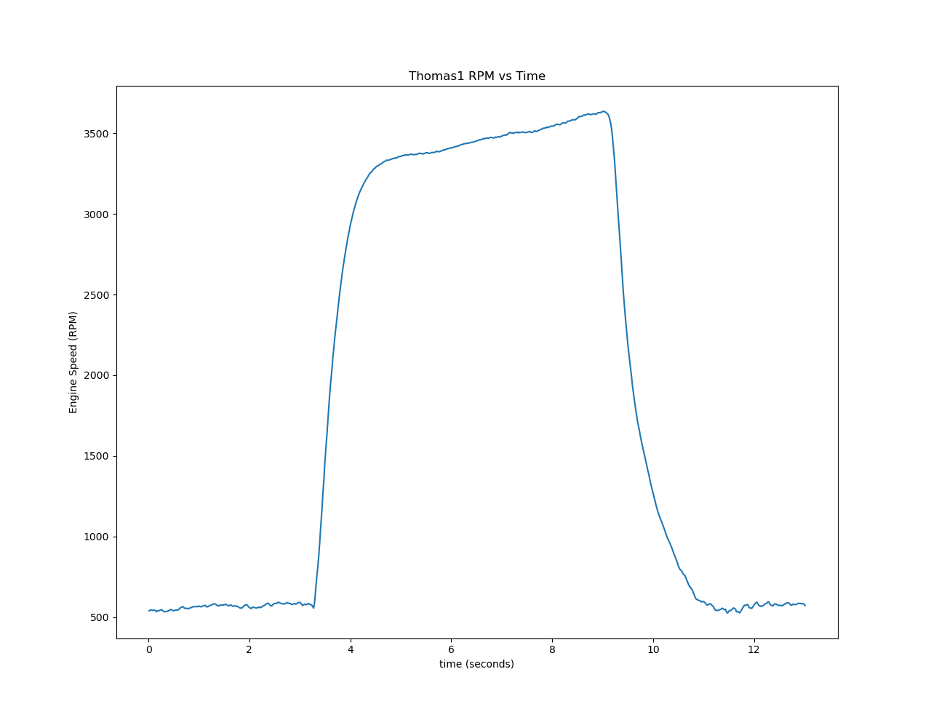
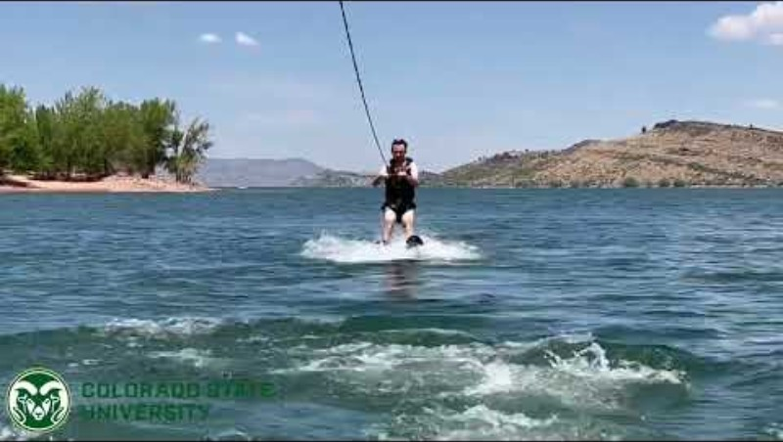
CAN not waterski
https://systemscyber.engr.colostate.edu/research/BoatingData
Notes:
Real world example that boats do have networks too!

Slide 4
Research Objectives
Could an attacker command-and-control a vessel entirely over the Internet?
Aftermarket “yacht gateways” are an ideal target, as they bridge NMEA 2000 networks (once air-gapped) to Wi-Fi and cloud services, with a low cost compared to alternatives
Context
Growing connectivity means every new onboard device becomes a potential entry point.
Similar precedent: Electronic Logging Devices (ELDs) opened J1939 trucking networks to remote attacks; yacht gateways pose the same risk to boats.
Evaluate, Identify, Demonstrate, and Mitigate risks found in a yacht gateway

Slide 5
Background – What is the Gateway?
Thumb‑sized Wi‑Fi bridge for NMEA 2000 / NMEA 0183 networks
Acts as Access Point (AP) or joins onboard network in Client mode
Converts traffic both ways; can steer Raymarine autopilots
Thousands of units estimated in service worldwide
Ships with default SSID & password hardcoded into each unit sold
AP pass: 12345678
Administrative application: admin/admin
Notes:
It’s like selling a lock with the key taped to it, but including a warning in the manual: "Remove the key after installation."

Slide 6
Methodology Overview
Hardware teardown & component identification (ESP8285, STM32)
Firmware extraction via UART bootloader
Network enumeration with Nmap & raw packet capture
Web‑app testing with Burp Suite & OWASP ZAP
Proof‑of‑concept scripts for NMEA 2000 spoofing

Slide 7
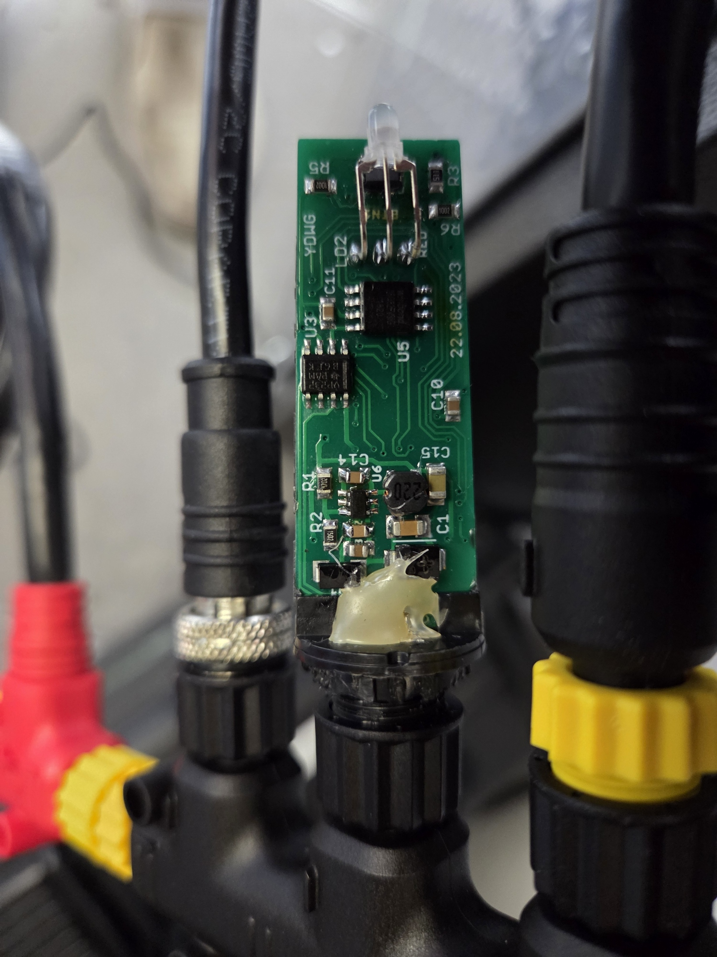
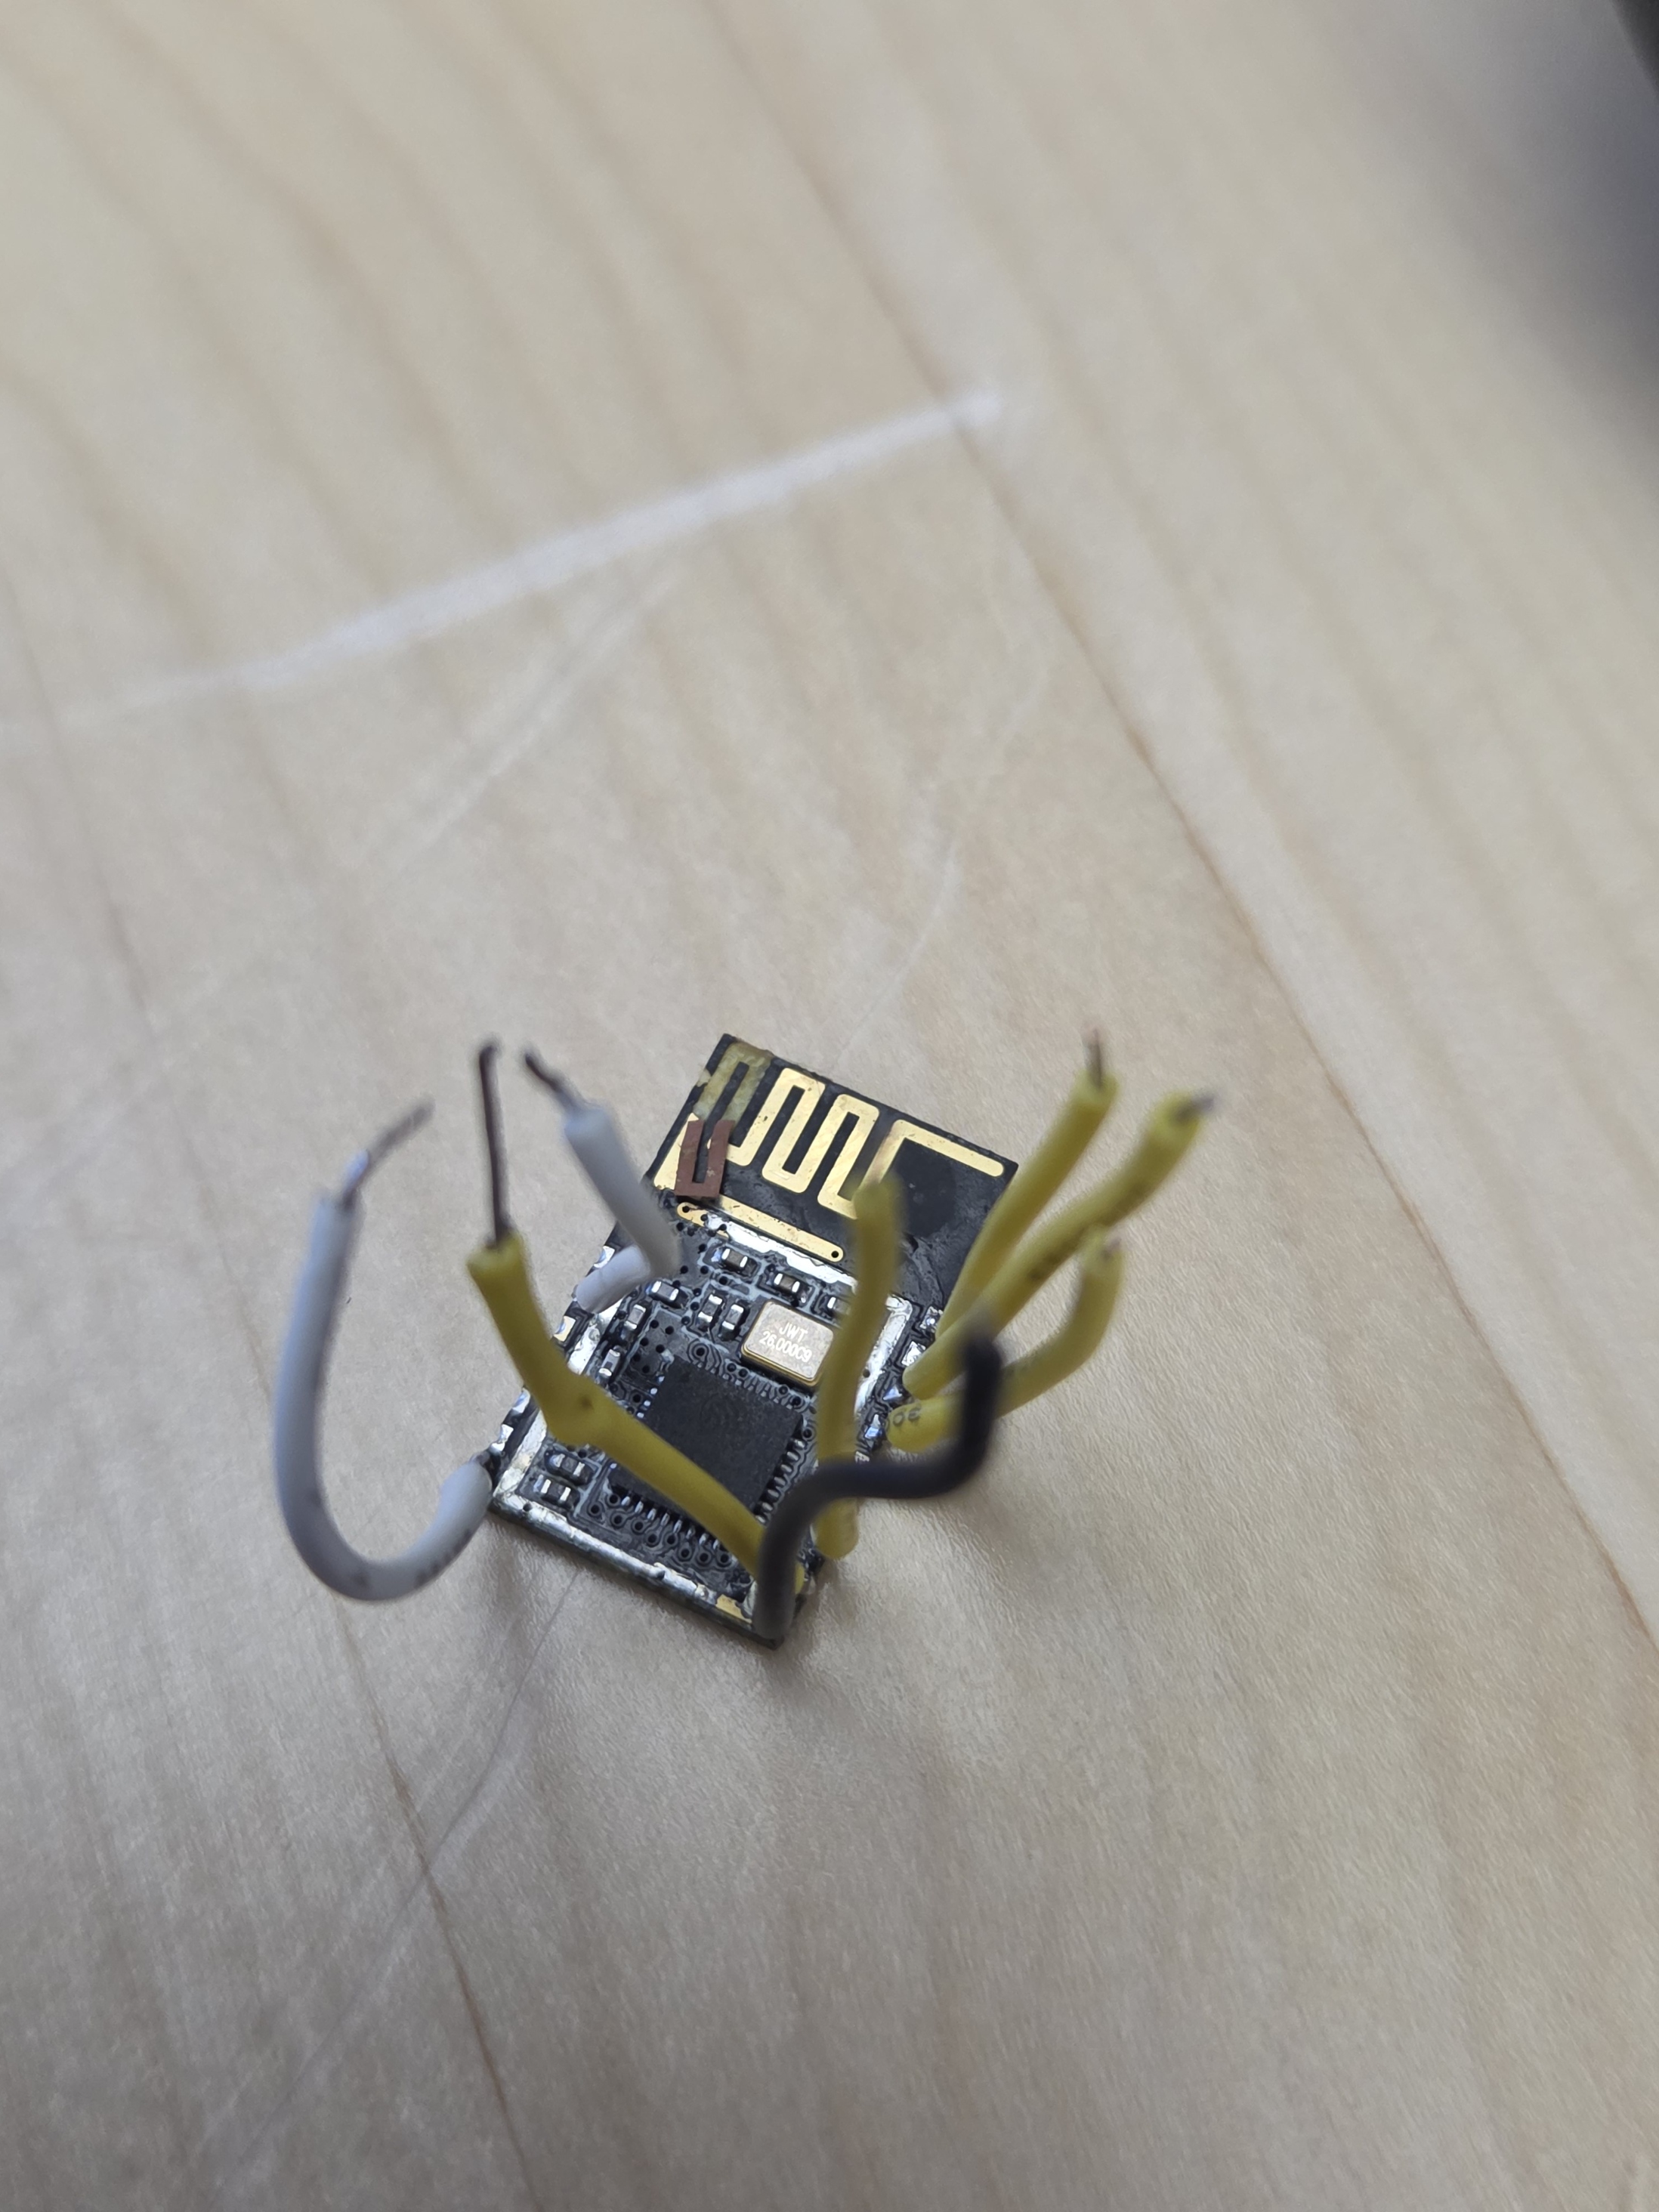
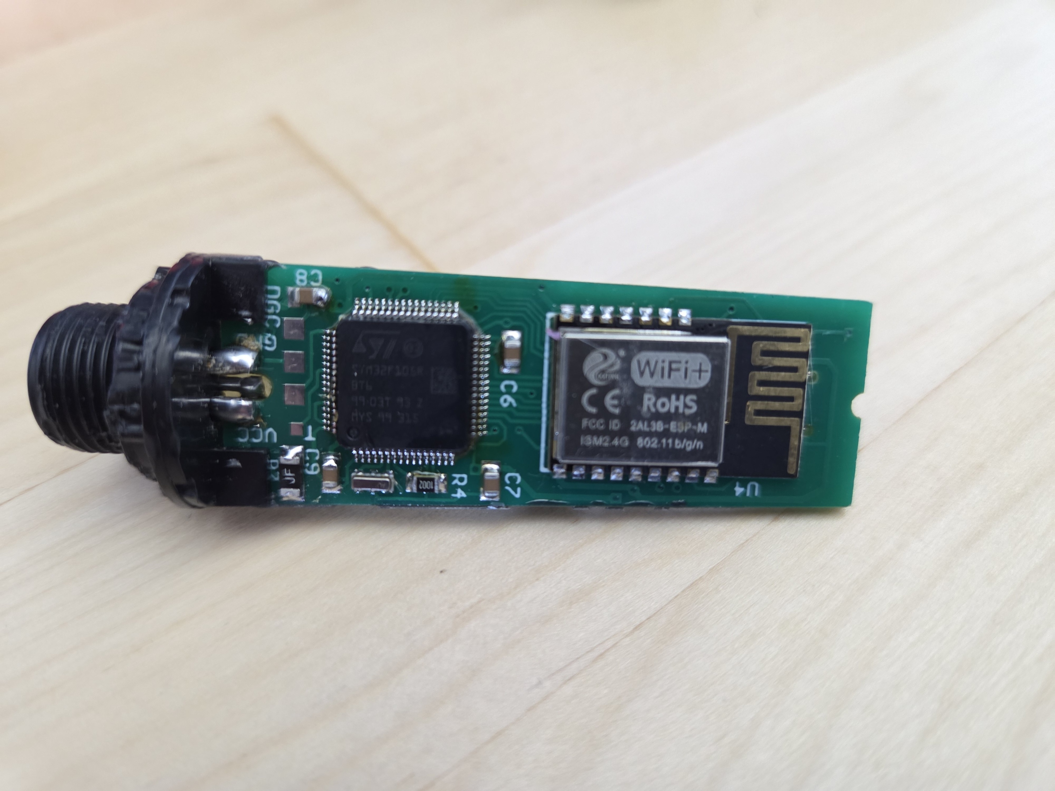
Hardware Insights
Assumed that ESP8285 SoC handles Wi‑Fi & web interface; STM32 drives CAN bus[1]
Unencrypted flash memory dump from the ESP8285 using the manufacturer provided tool (esptool.py[2])
[1] “esp8285 and stm32 ota update” Google Search. Google. 20-May-2025. [Online]. Available: https://www.google.com/search?q=esp8285+and+stm32+ota+update.
[2] Espressif Systems, “esptool,” GitHub repository. [Online]. Available: https://github.com/espressif/esptool.

Slide 8
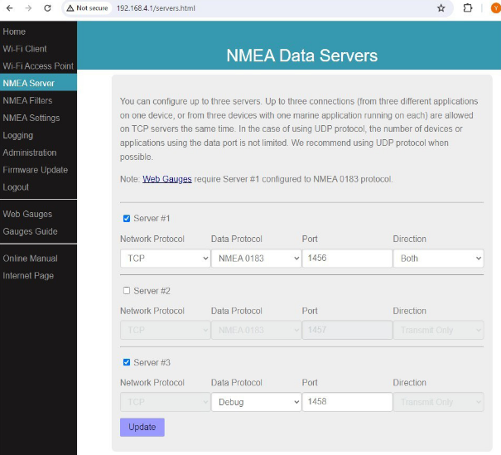
Network & Web Reconnaissance
Exposed ports: 80 (HTTP), 145[6-8] (NMEA 0183 & RAW protocols) *
Port 1456 streams live NMEA 0183 in cleartext by default *
Bidirectional mode lets attacker inject CAN messages
AJAX endpoints leak credentials & config over HTTP
Session maintained only by replayable SHA‑1 cookie
Administrative web application
* Mentioned in the manufacturer’s user manual

Slide 9
Snapshot of Key Findings
Default credentials on web UI & Wi‑Fi (CWE‑798) *
Weak / replayable session cookies (CWE‑326 / 565)
Cleartext credential transmission (CWE‑319)
Unauthenticated NMEA services → CAN injection (CWE‑345)
XSS, Clickjacking & open WebSocket endpoints (CWE‑79 / 1021 / 306)
Cloud telemetry URLs publicly discoverable (CWE‑200 / 639)
* Mentioned in the manufacturer’s user manual

Slide 10
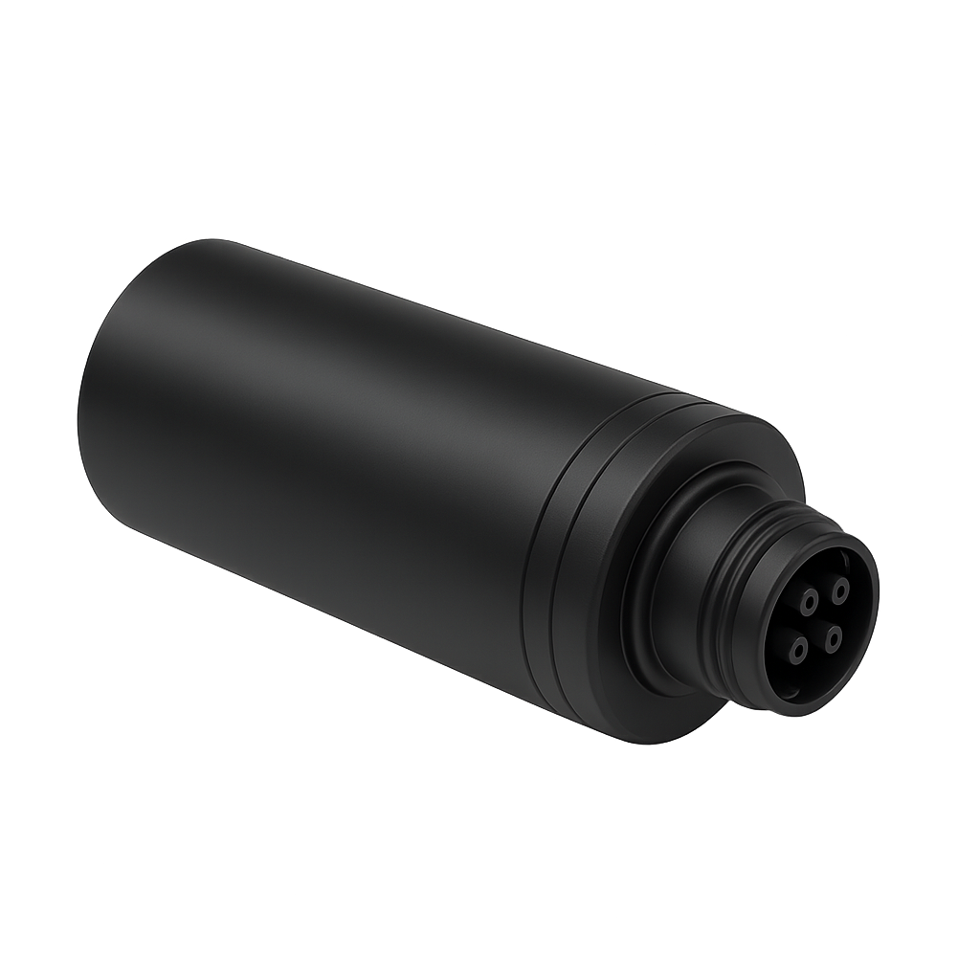

Cleartext Credential Transmission
MiTM
POST /login?1=1&login=admin&password=admin HTTP/1.1
Host: 192.168.4.1
Content-Length: 0
Accept-Language: en-US,en;q=0.9
User-Agent: Mozilla/5.0 (Windows NT 10.0; Win64; x64) AppleWebKit/537.36 (KHTML, like Gecko) Chrome/135.0.0.0 Safari/537.36
Accept: */*
Origin: http://192.168.4.1
Referer: http://192.168.4.1/login.html
Accept-Encoding: gzip, deflate, br
Connection: keep-alive
POST /admin/changepassword?1=1&password=admin HTTP/1.1
Host: 192.168.10.71
Content-Length: 0
Accept-Language: en-US,en;q=0.9
User-Agent: Mozilla/5.0 (Windows NT 10.0; Win64; x64) AppleWebKit/537.36 (KHTML, like Gecko) Chrome/135.0.0.0 Safari/537.36
Accept: */*
Origin: http://192.168.10.71
Referer: http://192.168.10.71/admin.html
Accept-Encoding: gzip, deflate, br
Cookie: session=D033E22AE348AEB5660FC2140AEC35850C4DA997
Connection: keep-alive

Slide 11
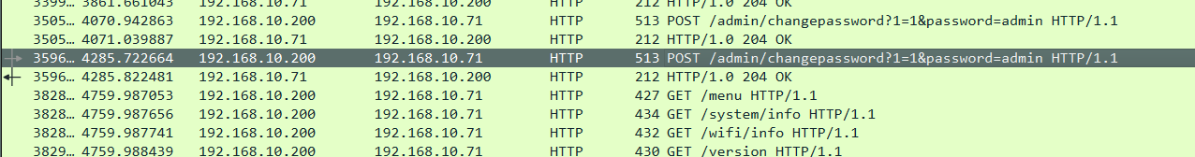
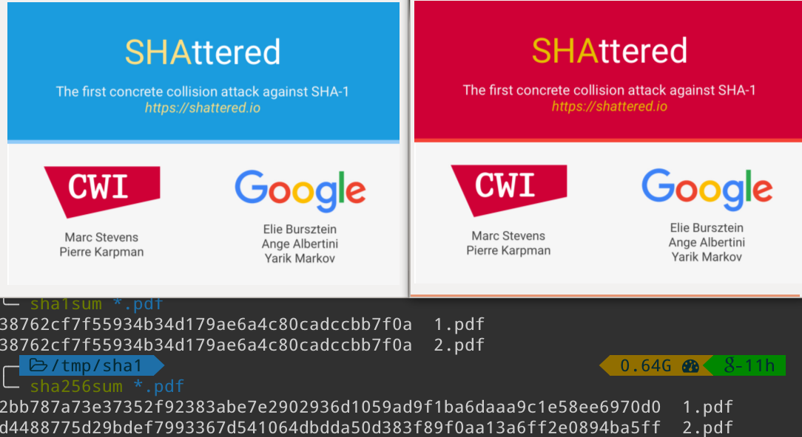
Insecure Session Cookie
This cookie we saw in the previous slide isn’t signed, meaning we can capture it and then use it to login by injecting our malicious POST request.
It is also hashed with what is now considered an insecure hashing algorithm
echo -n "admin" | sha1sum
d033e22ae348aeb5660fc2140aec35850c4da997 -

Slide 12
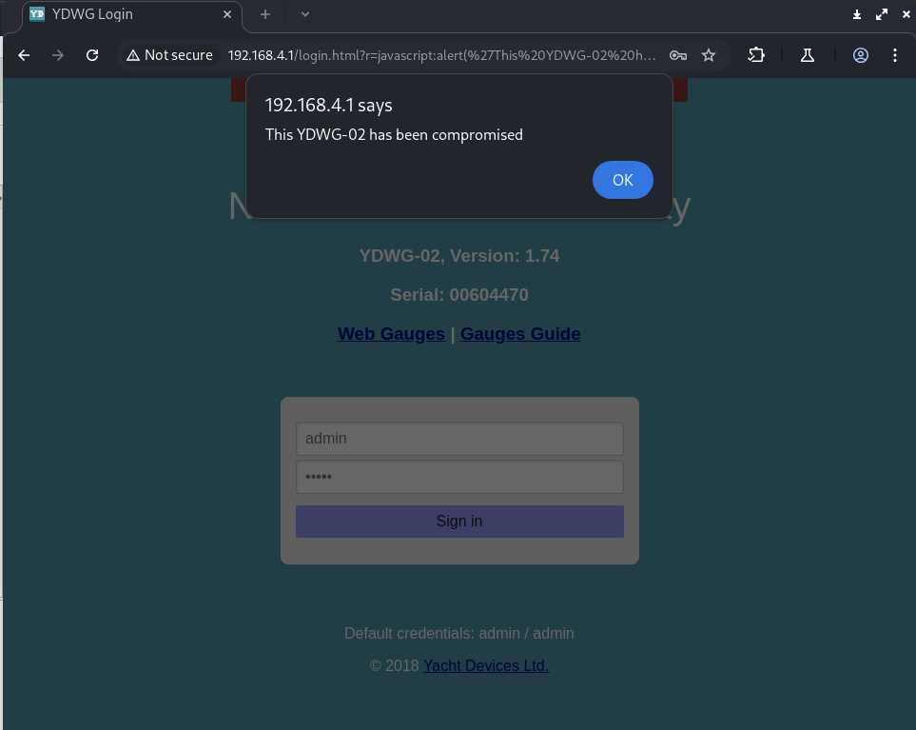
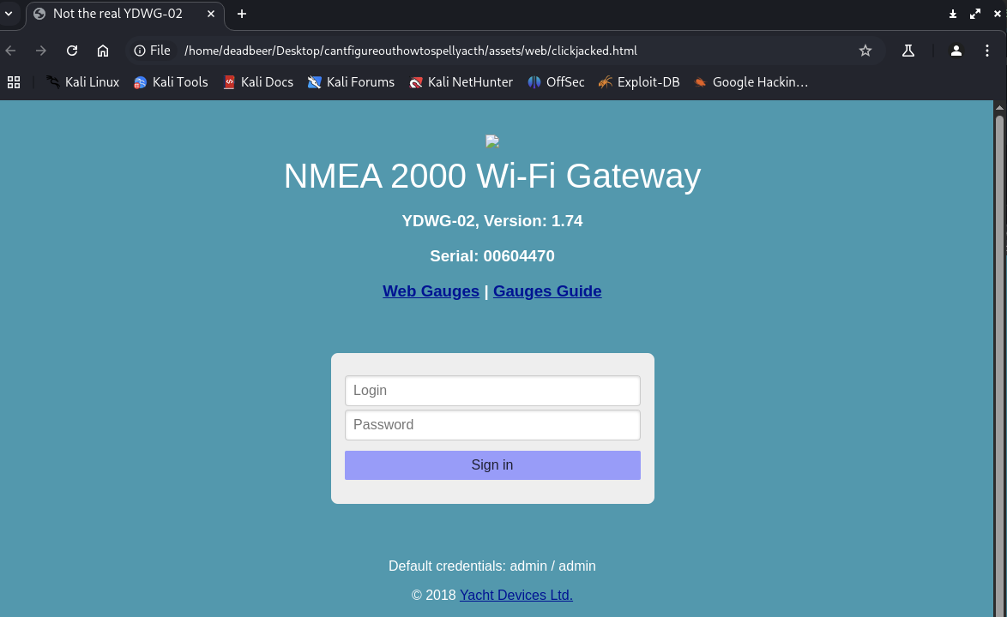
Web-App Vulnerabilities
XSS: “This YDWG-02 has been compromised”
Clickjacking: “Not the real YDWG-02”
Could be used as phishing attempts by an attacker
Notes:
Common consumer web app vulnerabilities

Slide 13
Endpoints expose configurations
POST /nmea_settings/update?1=1&ns_enabled0=1&ns_type0=0&ns_protocol0=0&ns_port0=1456&ns_direction0=1&ns_enabled1=0&ns_type1=1&ns_protocol1=1&ns_port1=1457&ns_direction1=3&ns_enabled2=1&ns_type2=0&ns_protocol2=2&ns_port2=1458&ns_direction2=1 HTTP/1.1
Host: 192.168.4.1
Content-Length: 0
Accept-Language: en-US,en;q=0.9
User-Agent: Mozilla/5.0 (X11; Linux x86_64) AppleWebKit/537.36 (KHTML, like Gecko) Chrome/135.0.0.0 Safari/537.36
Accept: */*
Origin: http://192.168.4.1
Referer: http://192.168.4.1/servers.html
Accept-Encoding: gzip, deflate, br
Cookie: session=D033E22AE348AEB5660FC2140AEC35850C4DA997
Connection: keep-alive
MiTM
Or open the possibility for a Denial of Service (DoS) → /flash/reboot
Notes:
Only a couple of many endpoints available on the administrative web app

Slide 14
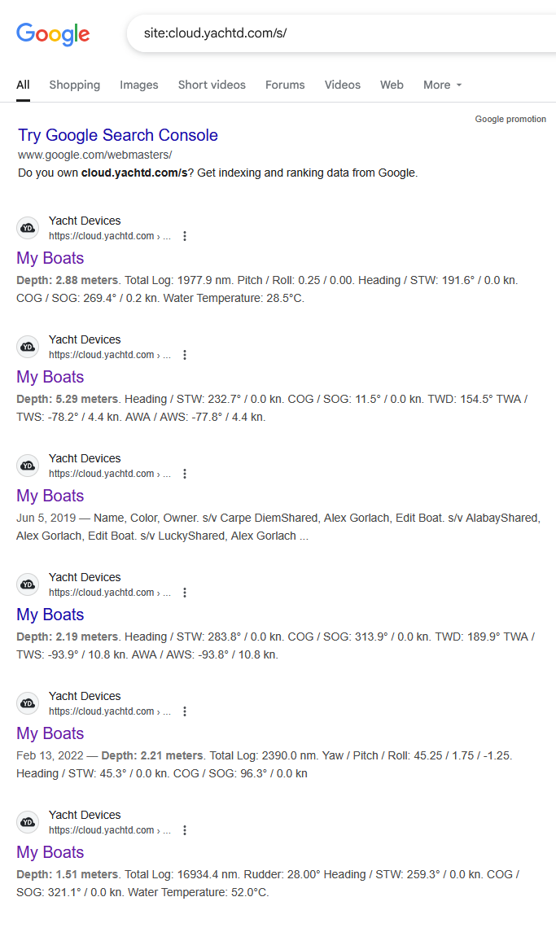
Cloud Data Exposure
HTTP/1.0 200 OK
Server: YDWG
Connection: close
Cache-Control: no-cache, no-store, must-revalidate
Pragma: no-cacheExpires: 0
Content-Type: application/json
{ "interval": "300", "points" : 16256, "priority" : 0, "dataset" : 7, "distance" : "true", "range" : 0, "key" : "Prolonged_blast$Pilot_boat*Fix~R2ushnLqH", "status" : "2025-05-02 20:42:19 Data uploaded (last point GMT 2024-12-19 21:58:00)", "has_points" : "false"}
"Secret" cloud URLs indexed by search engines (e.g., site:cloud.yachtd.com/s/) → anyone can view data.
Keys exposed over cleartext
Notes:
While not the focus of this research, there is still a call for concern here.

Slide 15
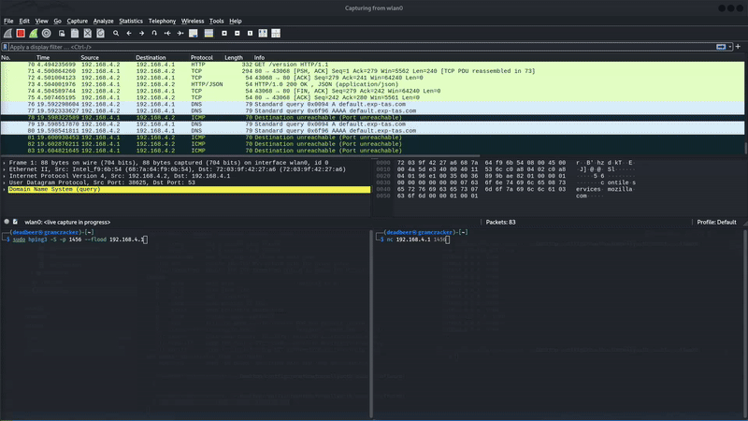
Denial of Service (TCP SYN Flood)
Notes:
Prevents the user from sending or receiving remote data. Could be critical if a user is bridging multiple yacht devices together to serve as a wireless NMEA gateway.

Slide 16
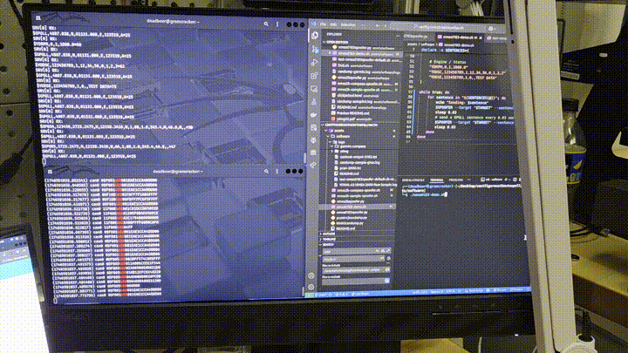
Demonstrations (more to come)
Notes:
MFD is completely fuzzed with the device using the gateway as the source of its navigational data.

Slide 17
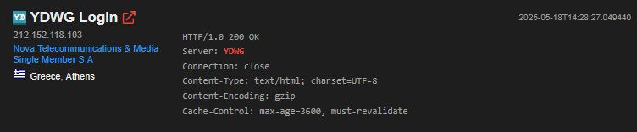
https://www.shodan.io/search?query=YDWG#:~:text=
Notes:
For people who think this isn’t feasible, need to get past the AP credentials, etc.

Slide 18
Recommendations
Unique per‑device credentials
TLS for web UI, firmware updates & NMEA streams; CSP / Anti-clickjacking headers
Replace SHA‑1 cookies with signed JWT‑like tokens (short‑lived)
Encrypt & authenticate bidirectional NMEA traffic
Rate‑limit management interfaces; enable secure boot
Access Control for Cloud and Edge Connected Devices

Slide 19
Conclusion & Future Work
Marine IoT inherits classic consumer‑IoT security gaps
Vendor cooperation is essential
Future: Firmware update analysis & further NMEA 2000 exploitations
Summary: In any industry where security and safety go together, there should not be:
Weak default credentials
Privacy concerns
Unauthenticated command & control

Slide 20

Questions?

